Slide 1
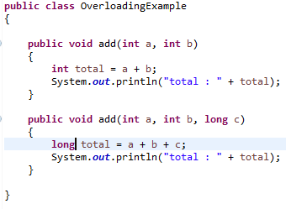
Method Overloading Vs. Method Overriding
Method overloading, also known as Function overloading or Compile time polymorphism, is a concept of having two or more methods with same name but different signature in the same scope.
As shown in the below example, the method ‘add’ is overloaded 2 times with different method signature, i.e. the type or the number of parameters are different.

Slide 2
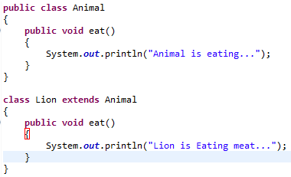
Method Overloading Vs. Method Overriding
Method overriding, also known as Function overriding or Run time polymorphism, is an OOP feature that allows a child class to provide its own implementation to the method defined in the parent class. The implementation in the child class overrides the definition of method in the base class, provided that the method in the child class should have the same name, signature and return type.
In the below example, the eat method in the Lion class overrides the eat method defined in the Animal class.

Slide 3
Method Overloading Vs. Method Overriding
Method Overloading | Method Overriding
In Method overloading methods must have different signature. | In method overriding methods must have same signature.
Function Overloading is to “add” or “extend” more to method’s behavior. | Function overriding is to completely “change” or “redefine” the behavior of a method.
Method overloading is used to achieve Compile time polymorphism | Method overriding is used to achieve run time polymorphism.
In method/function overloading, compiler knows which object assigned to which class at the time of compilation. | In method overriding, which object assigned to which class is not known till runtime.
Function Overloading takes place in a same class. | Overriding takes place in a class derived from a base class.

